Slide 1
Assignment 4

Slide 2
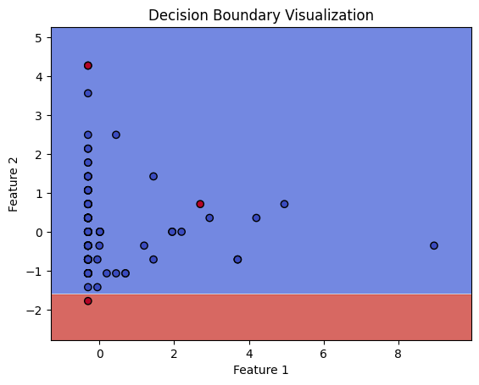
Question 1 – Decision Tree – Dataset 1
Average scores across the 5 folds Accuracy: 0.9592087168094785, Precision: 0.6592352092352092, Recall : 0.7527777777777778 , F1_score:0.6955555555555556
Scores on the test data Accuracy: 0.9709302325581395 Precision: 0.7142857142857143, Recall : 0.9090909090909091 , F1_score:0.8

Slide 3
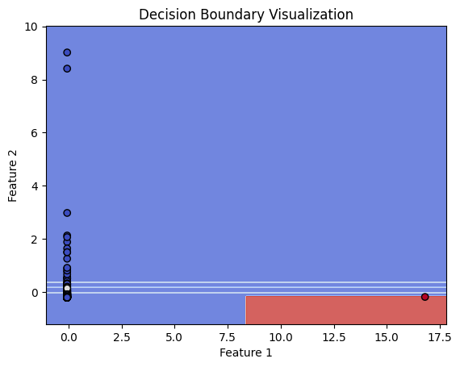
Question 1 – Decision Tree – Dataset 2
Average scores across the 5 folds Accuracy: 0.9334447085433618, Precision: 0.7871090233728315, Recall : 0.7668414019940385 , F1_score:0.7744072626941677
Scores on the test data Accuracy: 0.9203084832904884 Precision: 0.7592592592592593, Recall : 0.6949152542372882 , F1_score: 0.7256637168141593

Slide 4
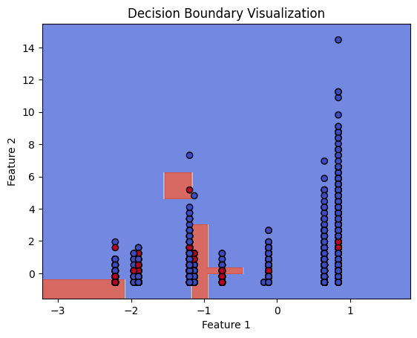
Question 1 – Decision Tree – Dataset 3
Average scores across the 5 folds Accuracy: 0.9134749620637329, Precision: 0.6510295213037104, Recall : 0.4992037090109667 , F1_score:0.5644962244793424
Scores on the test data Accuracy: 0.9140568099053168 Precision: 0.6598837209302325, Recall : 0.4892241379310345 , F1_score:0.5618811881188119

Slide 5
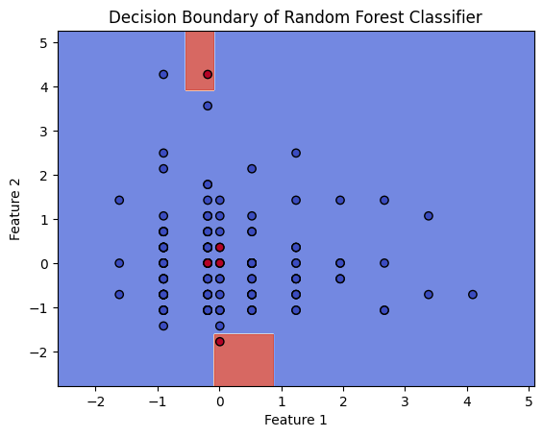
Question 2 – Random Forest – Dataset 1
Average scores across the 5 folds Accuracy: 0.948979160055009, Precision: 0.7416666666666666, Recall : 0.3666666666666667 , F1_score:0.46363440481087537
Scores on the test data Accuracy: 0.9476744186046512 Precision: 0.75, Recall : 0.2727272727272727 , F1_score:0.39999999999999997

Slide 6
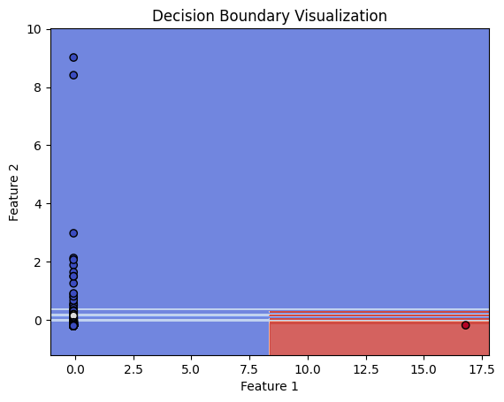
Question 2 – Random Forest – Dataset 2
Average scores across the 5 folds Accuracy: 0.9562529137587822, Precision: 0.929220836552257, Recall : 0.7696114708603146 , F1_score:0.8408480690357194
Scores on the test data Accuracy: 0.9514066496163683 Precision: 0.9, Recall : 0.7627118644067796 , F1_score:0.8256880733944953

Slide 7
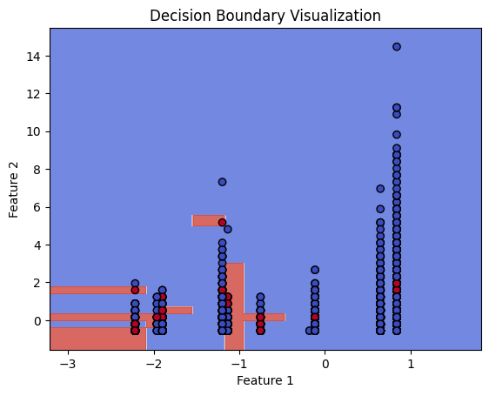
Question 2 – Random Forest – Dataset 3
Average scores across the 5 folds Accuracy: 0.9116843702579667, Precision: 0.6699718446197582, Recall : 0.4253804602162864 , F1_score:0.5202720601895694
Scores on the test data Accuracy: 0.9150279193979121 Precision: 0.6868852459016394, Recall : 0.4515086206896552 , F1_score:0.5448634590377114

Slide 8
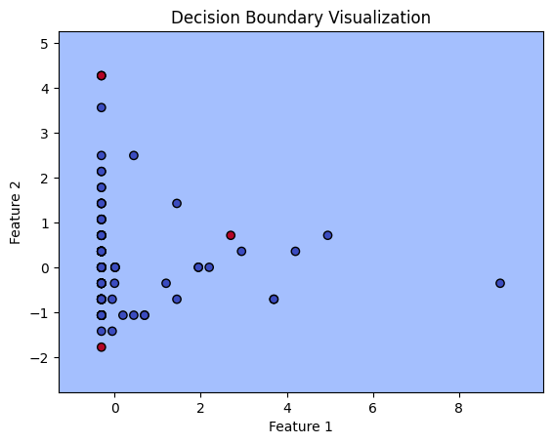
Question 3 – Random Forest – Dataset 1
Average scores across the 5 folds Accuracy: 0.9504601713741669, Precision: 0.5800000000000001, Recall : 0.5944444444444444 , F1_score:0.5736842105263157
Scores on the test data Accuracy: 0.9709302325581395 Precision: 0.8, Recall : 0.7272727272727273 , F1_score:0.761904761904762

Slide 9
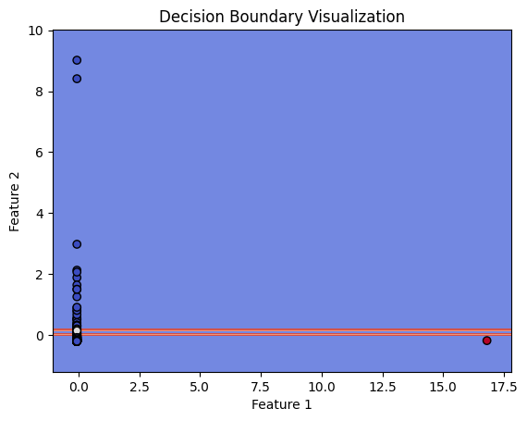
Question 3 – Random Forest – Dataset 2
Average scores across the 5 folds Accuracy: 0.9632749925718921, Precision: 0.9089766290989502, Recall : 0.8427035152636447 , F1_score:0.874108364753526
Scores on the test data Accuracy: 0.9536082474226805 Precision: 0.8846153846153846, Recall : 0.7931034482758621 , F1_score:0.8363636363636363

Slide 10

Question 3 – Random Forest – Dataset 3
Average scores across the 5 folds Accuracy: 0.9157207890743552, Precision: 0.651513385273202, Recall : 0.5412290089351467 , F1_score:0.59111156753261
Scores on the test data Accuracy: 0.9180626365622724 Precision: 0.6583229036295369, Recall : 0.5668103448275862 , F1_score:0.6091488129704691

Slide 11
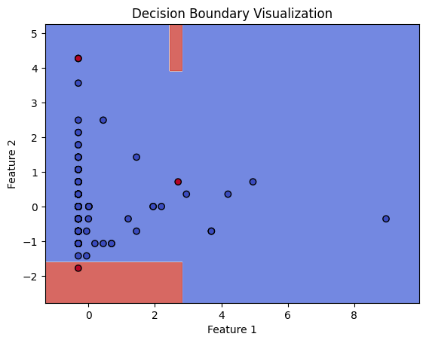
Question 4 – Random Forest – Dataset 1
Average scores across the 5 folds Accuracy: 0.9548079974611234, Precision: 0.6961111111111111, Recall : 0.5694444444444444 , F1_score:0.6162464985994399
Scores on the test data Accuracy: 0.9767441860465116 Precision: 0.8888888888888888, Recall : 0.7272727272727273 , F1_score:0.7999999999999999

Slide 12

Question 4 – Random Forest – Dataset 2
Average scores across the 5 folds Accuracy: 0.9433935063657085, Precision: 0.8178481117605605, Recall : 0.8084798026518657 , F1_score:0.8121586350157779
Scores on the test data Accuracy: 0.9539641943734015 Precision: 0.9019607843137255, Recall : 0.7796610169491526 , F1_score:0.8363636363636364

Slide 13
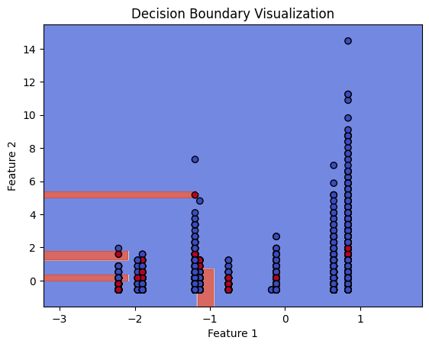
Question 4 – Random Forest – Dataset 3
Average scores across the 5 folds Accuracy: 0.9133839150227617, Precision: 0.6435237843683052, Recall : 0.5188584923799124 , F1_score:0.5744230143466561
Scores on the test data Accuracy: 0.91442097596504 Precision: 0.6500672947510094, Recall : 0.5204741379310345 , F1_score:0.5780969479353679

